Slide 1
Solving linear equations
Reference: Marvin L. Bittinger, Judith A. Beecher and Barbara L. Johnson, “Introductory and Intermediate Algebra”, 5th Edition, Pearson, 2015

Slide 2
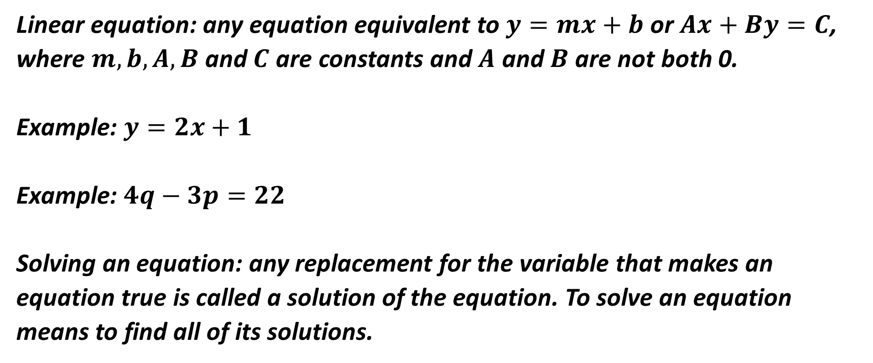
Linear equation: any equation equivalent to$y=mx+b$ or $Ax+By=C$, where $m, b, A, B$ and $C$ are constants and $A$ and $B$ are not both 0.
Example: $y=2x+1$
Example: $4q−3p=22$
Solving an equation: any replacement for the variable that makes an equation true is called a solution of the equation. To solve an equation means to find all of its solutions.

Slide 3
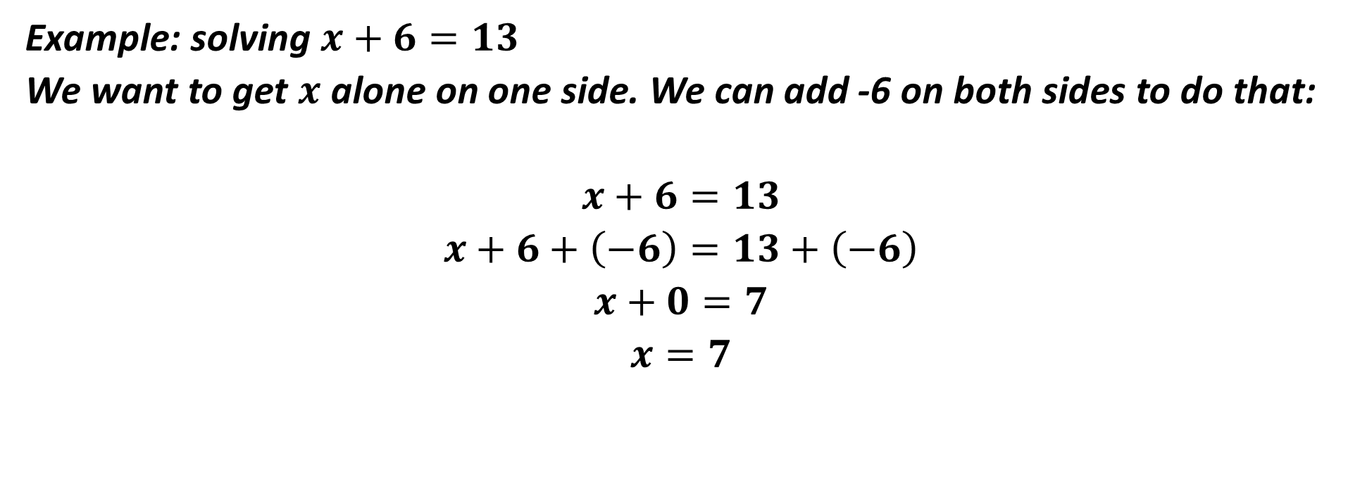
Example: solving $x+6=13$
We want to get $x$ alone on one side. We can add -6 on both sides to do that:
$$x+6=13$$
$$x+6+\left(−6\right)=13+\left(−6\right)$$
$$x+0=7$$
$$x=7$$

Slide 4
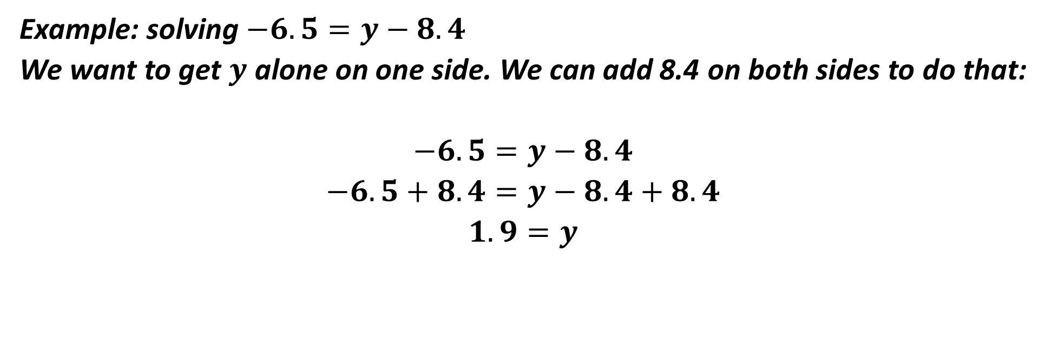
Example: solving $−6.5=y−8.4$
We want to get $y$ alone on one side. We can add 8.4 on both sides to do that:
$$−6.5=y−8.4$$
$$−6.5+8.4=y−8.4+8.4$$
$$1.9=y$$

Slide 5
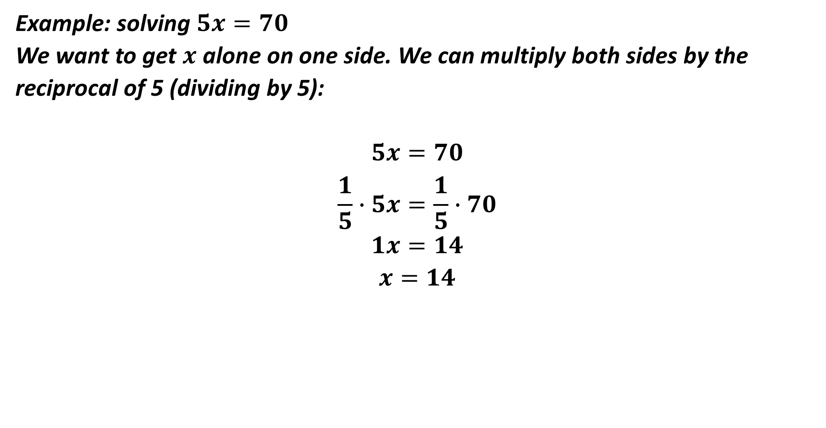
Example: solving $5x=70$
We want to get $x$ alone on one side. We can multiply both sides by the reciprocal of 5 (dividing by 5):
$$5x=70$$
$$\frac{1}{5}∙5x=\frac{1}{5}∙70$$
$$1x=14$$
$$x=14$$

Slide 6

Example: solving $\frac{3}{8}=−\frac{5}{4}x$
We want to get $x$ alone on one side. We can multiply both sides by the reciprocal of $−\frac{5}{4}$:
$$−\frac{4}{5}∙\frac{3}{8}=−\frac{4}{5}∙(−\frac{5}{4}x)$$
$$−\frac{12}{40}=1∙x$$
$$−\frac{3}{10}=x$$

Slide 7

Example: solving $3x+4=13$
We want to get $x$ alone on one side. We can subtract 4 on both sides and then divide by 3:
$$3x+4=13$$
$$3x+4−4=13−4$$
$$3x=9$$
$$x=3$$

Slide 8
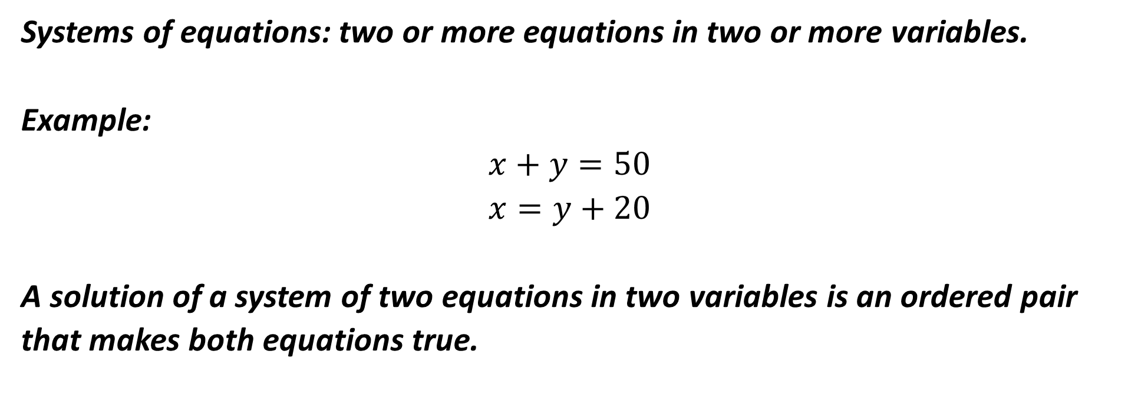
Systems of equations: two or more equations in two or more variables.
Example:
$$x+y=50$$
$$x=y+20$$
A solution of a system of two equations in two variables is an ordered pair that makes both equations true.

Slide 9

Example: solving the system:
$x+y=4$ (1)
$x=y+1$ (2)
From Equation (2): $x$ and $y+1$ are the same number so we can substitute $y+1$ for $x$ in Equation (1):
$$x+y=4$$
$$(y+1)+y=4$$
$$2y+1=4$$
$$2y+1−1=4−1$$
$$2y=3$$
$$y=\frac{3}{2}$$

Slide 10
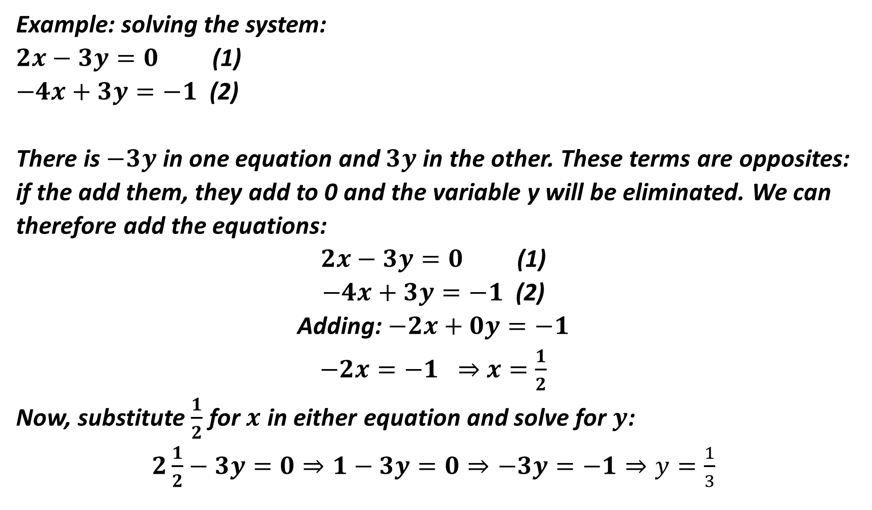
Example: solving the system:
$2x−3y=0$ (1)
$−4x+3y=−1$ (2)
There is $−3y$ in one equation and $3y$ in the other. These terms are opposites: if the add them, they add to 0 and the variable y will be eliminated. We can therefore add the equations:
$2x−3y=0$ (1)
$−4x+3y=−1$ (2)
Adding: $−2x+0y=−1$
$−2x=−1 ⇒$ $x=\frac{1}{2}$
Now, substitute $\frac{1}{2}$ for $x$ in either equation and solve for $y$:
$2\frac{1}{2}−3y=0$ $⇒$ $1−3y=0$ $⇒$ $−3y=−1$ $⇒$ $y=\frac{1}{3}$

